Slide 1

Image Super-Resolution -- Predictive Modelling
Spring 2019 Group 11
Presented by Yiyang Zeng

Slide 2

Objective
Mission: to create an mobile AI program that can enhance the resolution of blurry and low-resolution images
Task: to build machine learning models that can translate pixels of low-resolution images into the ones of high-resolution images
Evaluation Metric:
Computational Efficiency: Running Time
Predicting Power: PSNR

Slide 3

Overview
Feature Extraction
Baseline Model:
Generalized Boosted Regression Modeling (GBM)
Improved Model:
Extreme Gradient Boosting Machine (XGB)

Slide 4
Feature & Label Extraction
LR Images
Vectorization
1x8 Vector – Scalar
[X1, X2 … X8] - ct
FeatMat
0 | 0 | 0 | 0 | 0
0 | X1 | X4 | X6 | 0
0 | X2 | ct | X7 | 0
0 | X3 | X5 | X8 | 0
0 | 0 | 0 | 0 | 0
Sampling
Read HR/LR Pairs
Randomly Sample 1000 points from LR
Vectorization
HR Images
1x4 Vector
[Y1, Y2, Y3, Y4]
Y2 | Y1
Y3 | Y4
LabMat

Slide 5

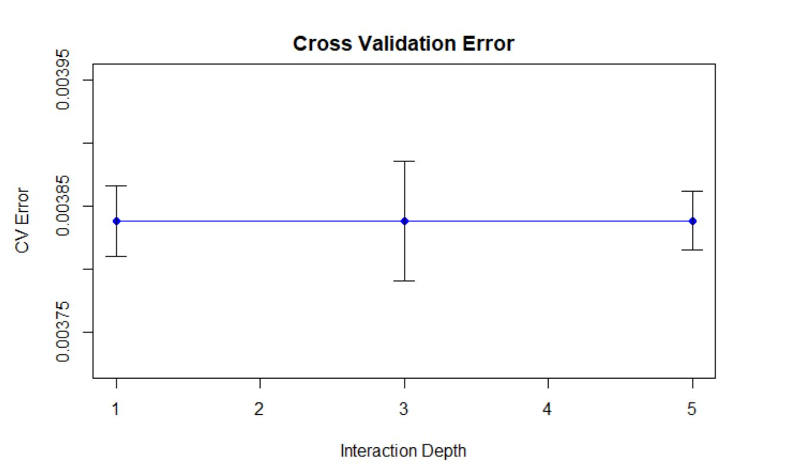
Baseline Model: GBM
3 Fold Cross Validation
Tuning parameter: Intraction_depth
GBM function:
n.trees = 200
Distribution = “Gaussian”
Interaction_Depth = 3

Slide 6
GBM Performance
Computationally expensive
Bad Accuracy
 | Feature Construction | Model Training | Super-Resolution
Total Time (sec) | 338.55 | 552.75 | 69.02 (99 test images)
Per Image Time (sec) | 0.23 | 0.37 | 0.70
PSNR | Around 20

Slide 7
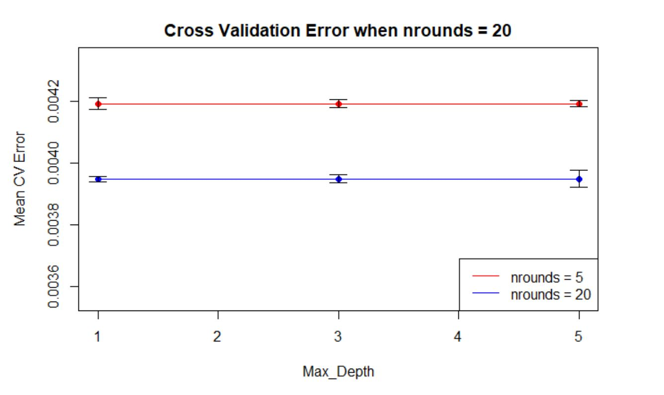
Improved Model: XGB
Regularized gradient boosting machine
5-fold cross validation
Two tuning parameters: max_depth, nrounds
Convert data into xgb.Dmatrix data type for fast computation
Xgboost function from XGB package:
Booster = “gblinear”
Max_depth = 3
Nrounds = 20

Slide 8
XGB Performance
Model Advantage:
Reduce overfitting with regularization techniques
Computationally efficient
Extremely Short implementation time
Good Accuracy
 | Feature Construction | Model Training | Super-Resolution
Total Time (sec) | 361.06 | 465.03 | 28.79 (99 test images)
Per Image Time (sec) | 0.24 | 0.31 | 0.29
PSNR | 26.83

Slide 9
Model Comparison
 |  | GBM | XGB
Accuracy | Mean Test PSNR | 20 | 26.83
Efficiency | Feature Construction Time | 338.55 | 361.06
 | Model Training Time | 552.75 | 465.03
 | Super-Resolution (99 Test Images) | 69.02 | 28.79

Slide 10


Potential Improvement
Variance-Based Sampling Strategy vs Random Selection during Feature Extraction
More Vectorization on Feature Extraction Process
Deep Learning Models (CNN) vs Machine Learning Models (Boosted Gradient Machines)

Slide 11

Thank you!

